Slide 1
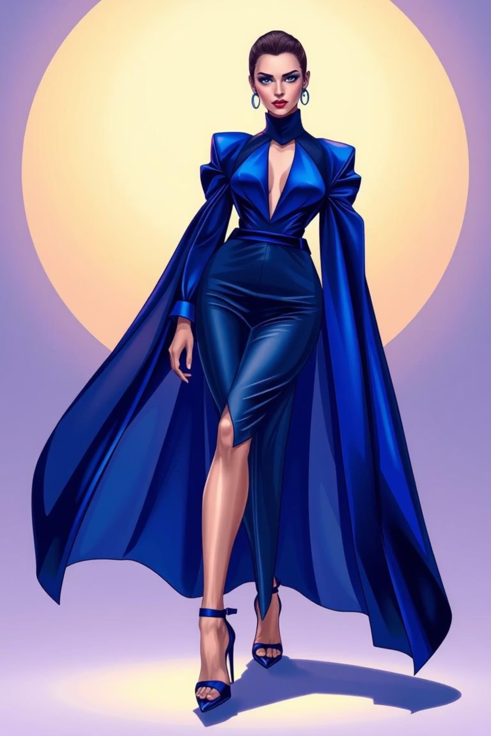
ReStyleAI: Closing the Loop in Fashion Waste
Selected Domain: AI in Other Domain (Sustainable Fashion)
Submitted By: DEEPIKA NARENDRAN
Mail ID: Deepika2.ytb@gmail.com

Slide 2

The Fast Fashion Crisis: A Global Challenge
Massive Waste Generation
Inefficient Circularity
Environmental Degradation
Approximately 92 million tons of textile waste are generated annually, with only 15% recycled or reused. This contributes significantly to landfills and pollution.
Consumers face challenges in reselling quality pre-owned clothing due to a lack of efficient platforms for intelligent matching. The current ecosystem is fragmented.
The core problem lies in inefficient clothing circularity, leading to substantial environmental damage from production to disposal. This linear model is unsustainable.

Slide 3




ReStyleAI: The Style Revival Engine
AI-Powered Analysis
Intelligent Matching
Environmental Impact
Our platform leverages computer vision to meticulously analyse clothing attributes like style, colour, and pattern.
We connect sellers with ideal buyers through a sophisticated style compatibility algorithm, ensuring optimal matches.
Each transaction quantifies environmental savings, providing tangible proof of sustainable consumption.
Our key innovation is a multimodal AI-powered style-to-style matching algorithm, revolutionising clothing circularity.

Slide 4
Robust Technology Stack
AI Engine
CLIP (Contrastive Language-Image Pretraining), OpenCV, Scikit-learn
Backend
Python, Firebase/FastAPI
Frontend
Streamlit (Web Demo)
Computer Vision
DeepFashion2 dataset, Image Embeddings
Deployment
Docker, Google Cloud Platform
This comprehensive stack ensures high performance, scalability, and robust AI capabilities for ReStyleAI.

Slide 5
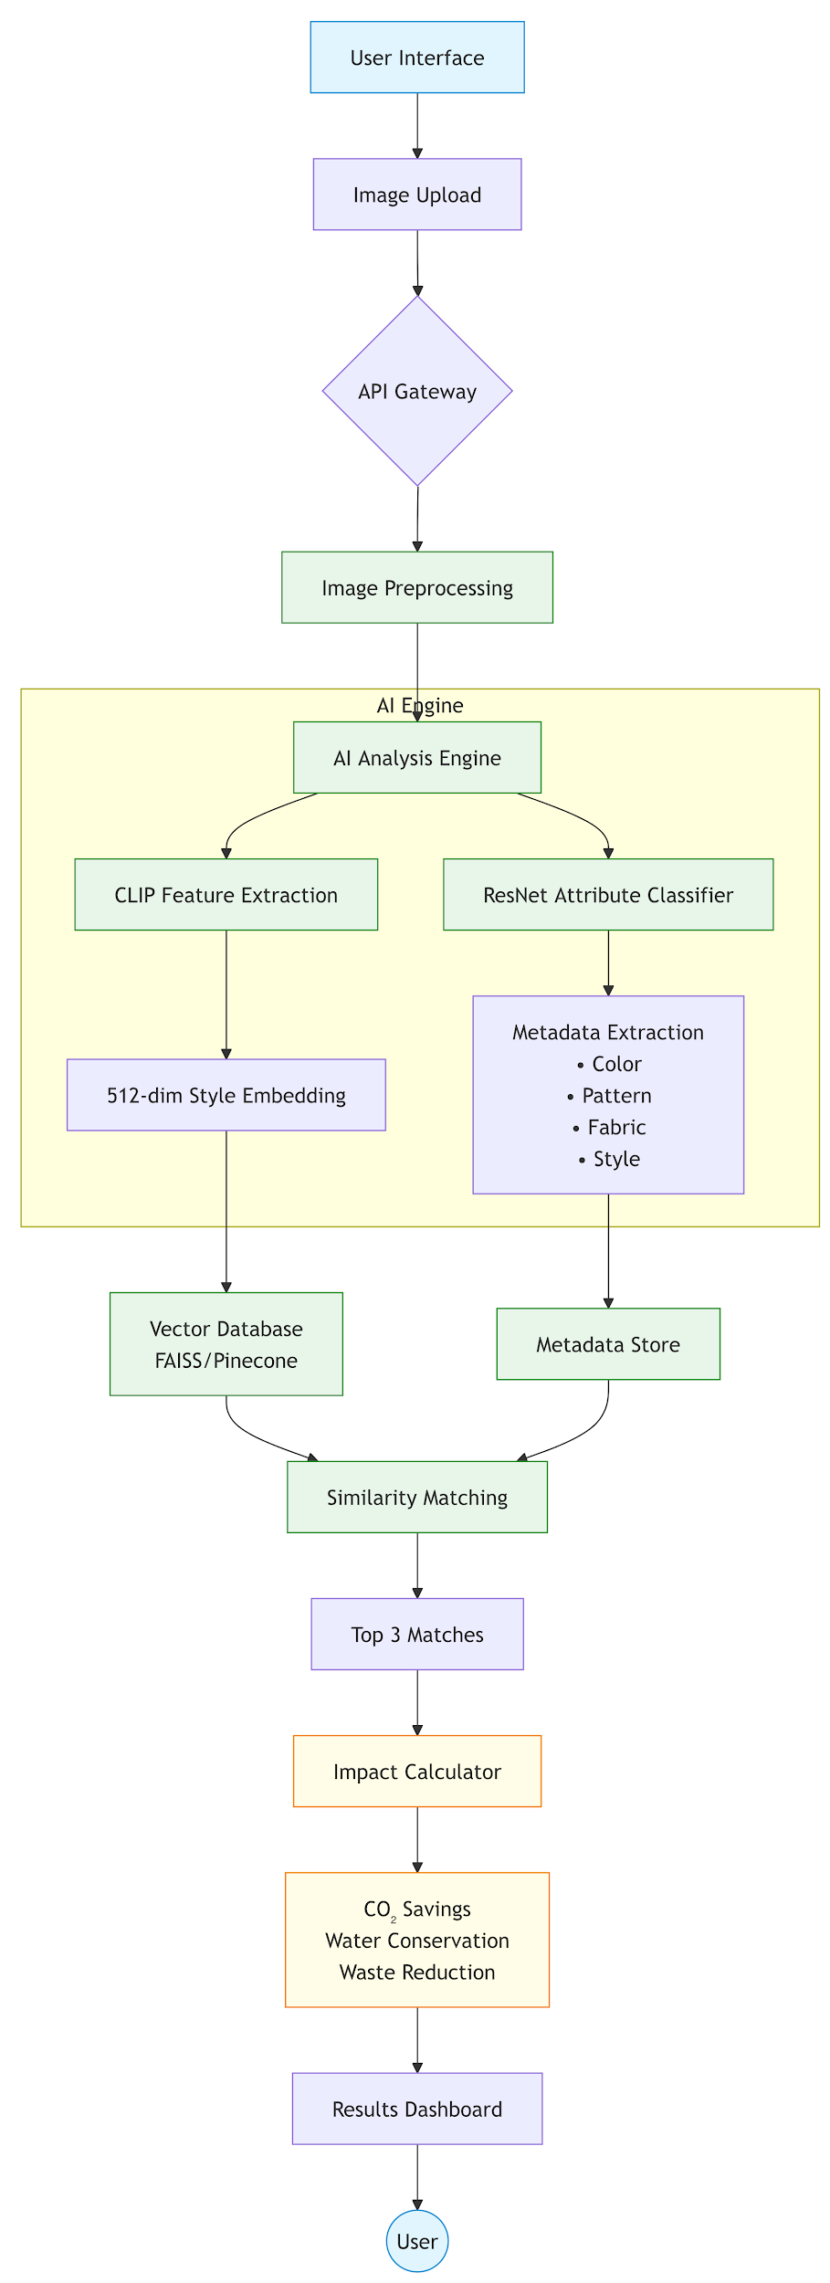
System Architecture Overview
The architecture integrates computer vision for attribute analysis, a multimodal AI engine for matching, and a robust backend for seamless operations. Data security and scalability are paramount.

Slide 6

Expected Outcomes & Impact
Technical Milestones
Business Value Proposition
Achieve 85% accuracy in style attribute detection.
Generate revenue through a commission-based model on successful transactions.
Ensure a rapid 3-second matching response time.
Scalable to process over 100,000 clothing items efficiently.
Unlock diverse brand partnership opportunities for extended reach and value.
Environmental Contribution
Position ReStyleAI as a leader in sustainable fashion technology.
Save 5kg CO₂ per transaction, significantly reducing carbon footprint.
Conserve 1,000 litres of water per item, promoting resource efficiency.
Targeting a 10-ton waste reduction within the first year of operation.

Slide 7

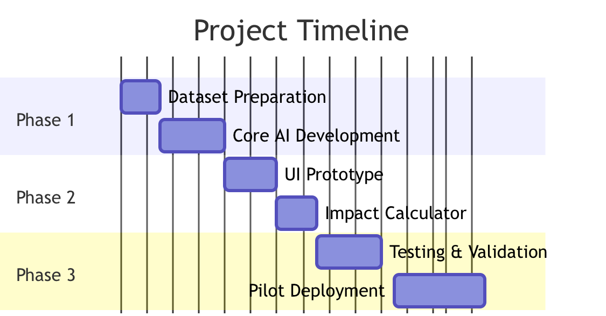
Implementation Roadmap: Phased Approach
Phase 3: Scaling & Deployment
Phase 1: Prototype Development
Optimise for large-scale deployment, implement advanced analytics, and explore brand integrations. Deliverables: Production-ready platform.
Focus on core AI matching engine, basic frontend, and initial dataset training. Deliverables: MVP with image upload and basic matching.
1
2
3
Phase 2: Feature Enhancement
Integrate environmental impact calculation, expand dataset, refine UI/UX, and develop robust backend. Deliverables: Impact Dashboard.

Slide 8
Key Deliverables & Competitive Advantage
Key Deliverables
Competitive Advantage
Functional Prototype: A web demo showcasing image upload and AI-powered matching capabilities.
The first AI solution uniquely focused on style compatibility for circular fashion, addressing a critical market gap.
Impact Dashboard: Real-time visualisation of CO₂ and water savings per transaction.
Our patent-pending matching algorithm ensures superior accuracy and relevance in recommendations.
Technical Documentation: Comprehensive details on algorithm design, validation approach, and system architecture.
Seamless integration with sustainability metrics provides tangible environmental benefits, setting us apart.
ReStyleAI is poised to transform the fashion industry by making circularity not just sustainable, but also stylish and smart.

Slide 9
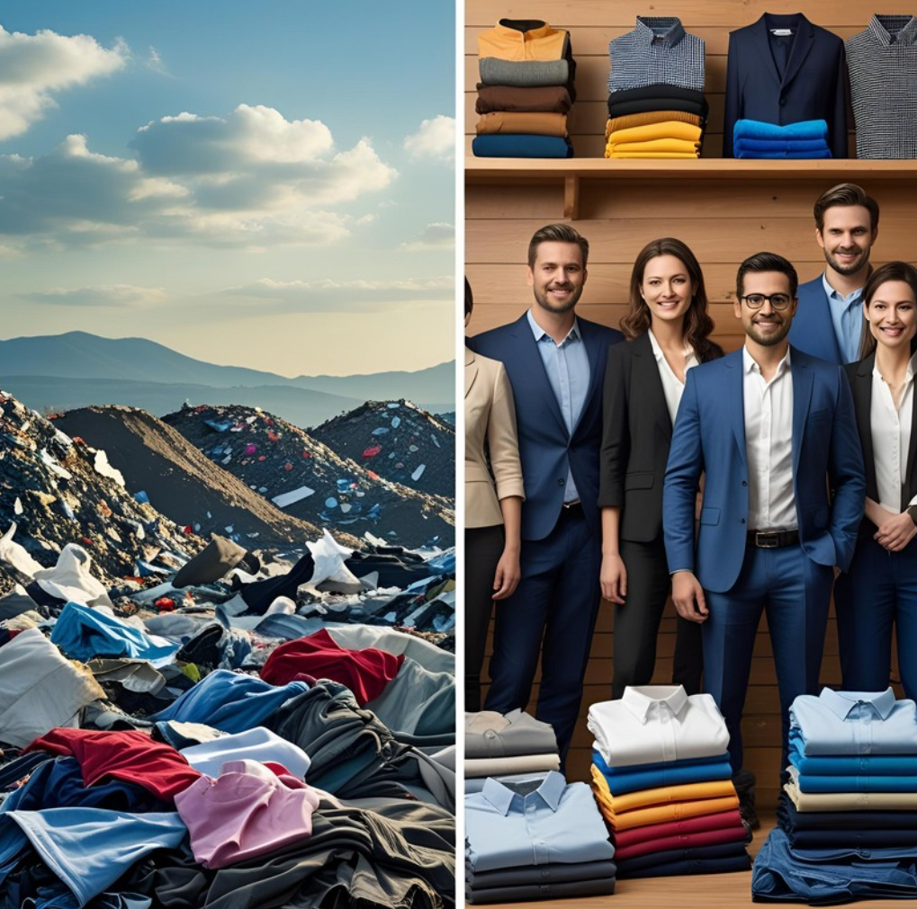
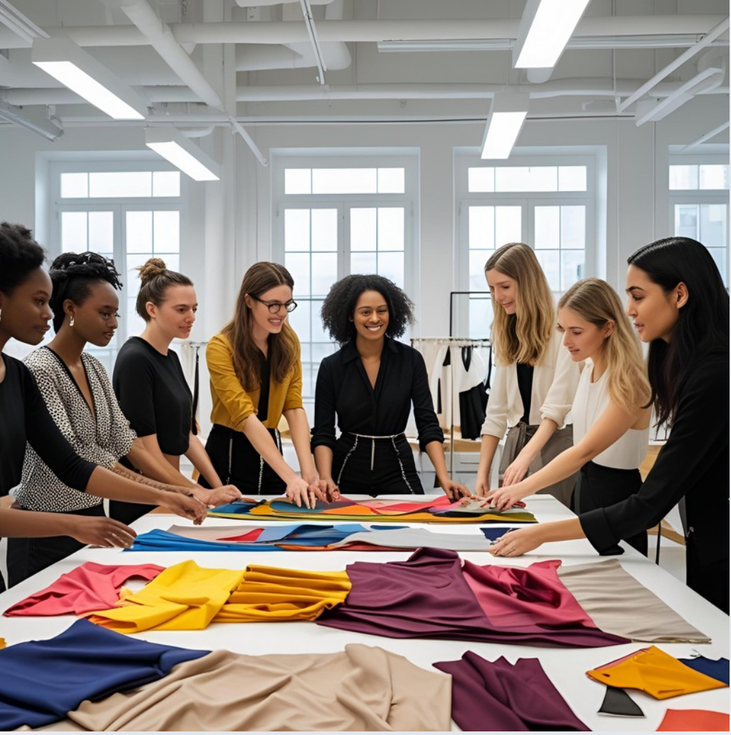
Conclusion & Impact
"We transform fashion waste by treating style as renewable energy."
First solution merging computer vision, behavioral economics, and circular economy principles
Demonstrable 10X improvement over current resale platforms
Measurable Impact
Metric Immediate Goal Year 1 Target
CO₂ Reduction 5kg per item 10 tons
Water Conservation 1,000L per item 2 million liters
Textile Waste Diverted 85% matched items 8 tons
Future Roadmap
Phase 1 (Scale)
Mobile app with AR try-on feature
Blockchain verification for item history
Phase 2 (Global)
Integration with retail POS systems
AI-driven textile recycling optimization
Phase 3 (Pilot)
Campus implementation at 3 universities
Partner with 5 sustainable brands
Submitted By: DEEPIKA NARENDRAN
Mail ID: Deepika2.ytb@gmail.com
"Joining the fashion revolution where every matched style heals our planet"

